Slide 1
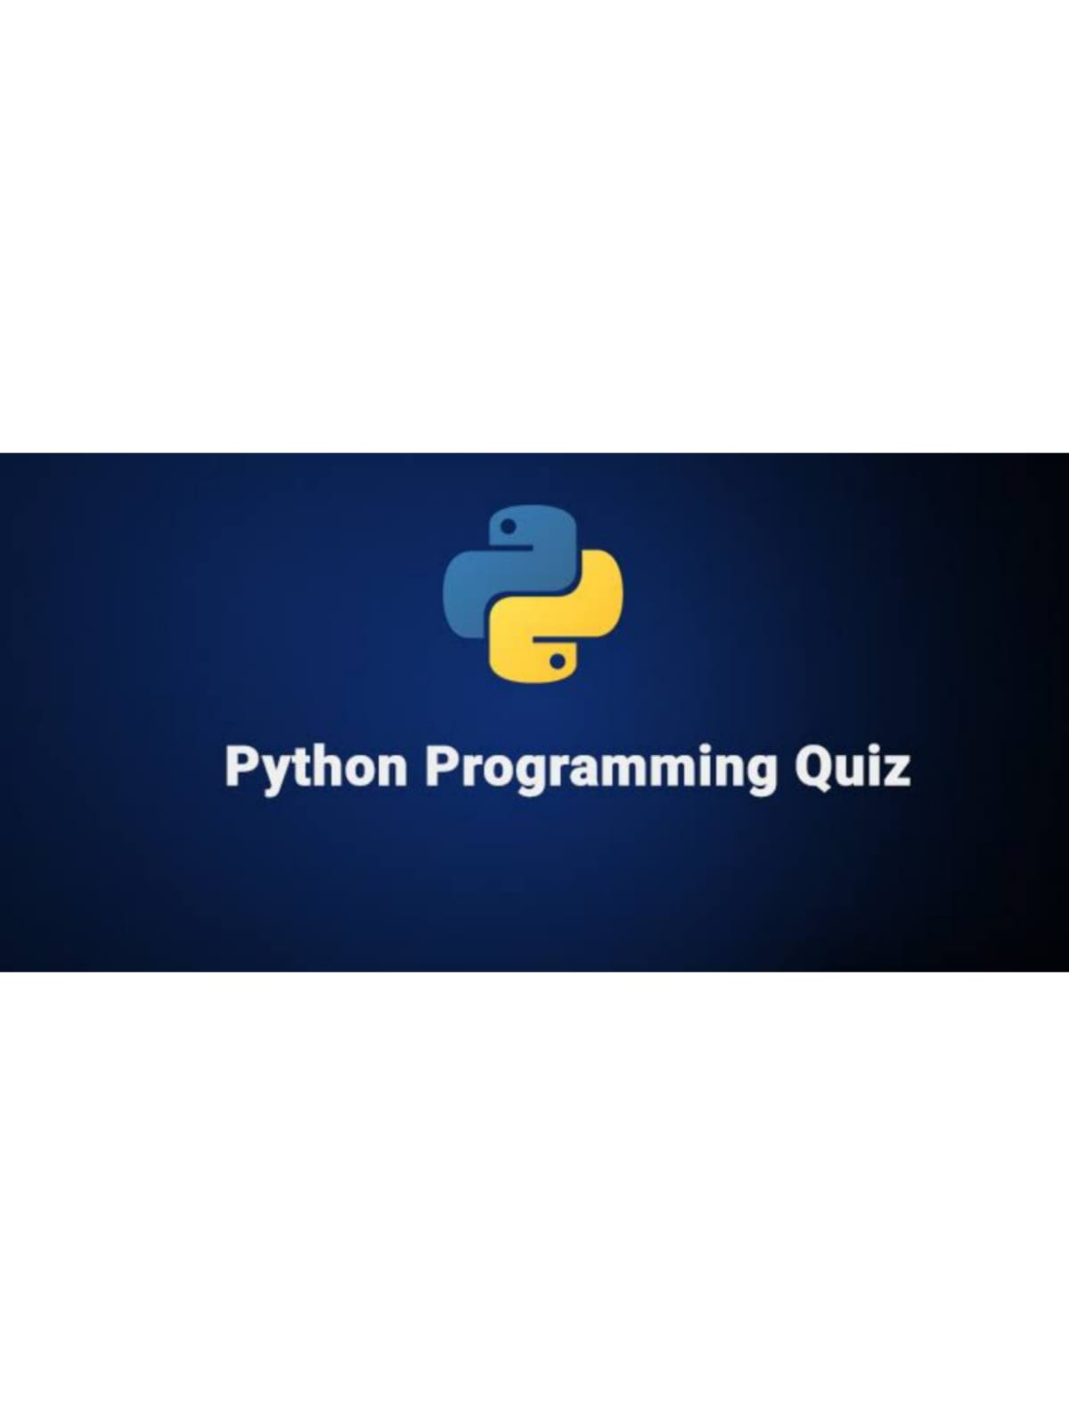
QUIZ PROGRAM
BY SUMIT MISHRA .

Slide 2
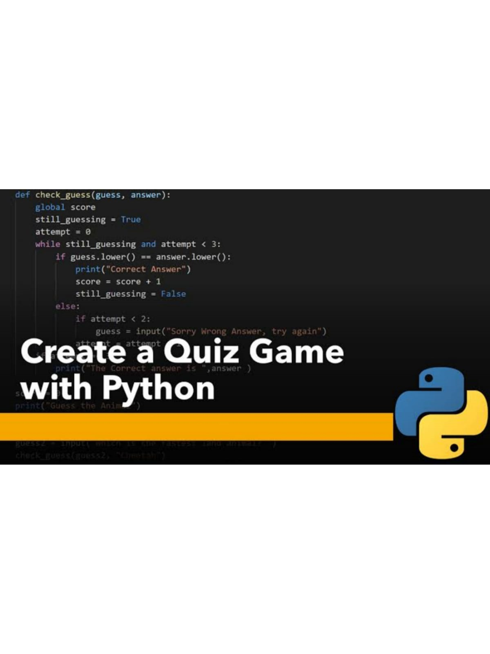
Introduction
Each quiz takes you through a series of questions. Some of them are multiple choice, some will ask you to type in an answer, and some will require you to write actual Python code. As you make your way through each quiz, it keeps score of which questions you answered correctly..​

Slide 3
How we get there​
1st I created a dictionary for questions and set the question as a key and its Ans as its value.
than I created a nested list which consist of options for user to display.
Than i created 3 functions, each functions has its different role.
New_ game () consist of 3 variable - guesses = [], Correct_ Guess = 0,questions_num=1
In this function I used 1st for loop for a displaying questions and 2nd for loop for displaying options to users

Slide 4
a variable called guess is used for taking input from the users and using .upper function to convert the user input in to upper case
now adding this value to the list which we define earlier (guesses)
Then we are calling Check_ Ans function to check the answers given by the users, it takes to parameters (answer, guess)
Now using if else conditions and returning values either 1 or 0 depending upon the answer
Than finally to display the result to the user I called Display_ score function in which simply displaying the result of user

Slide 5
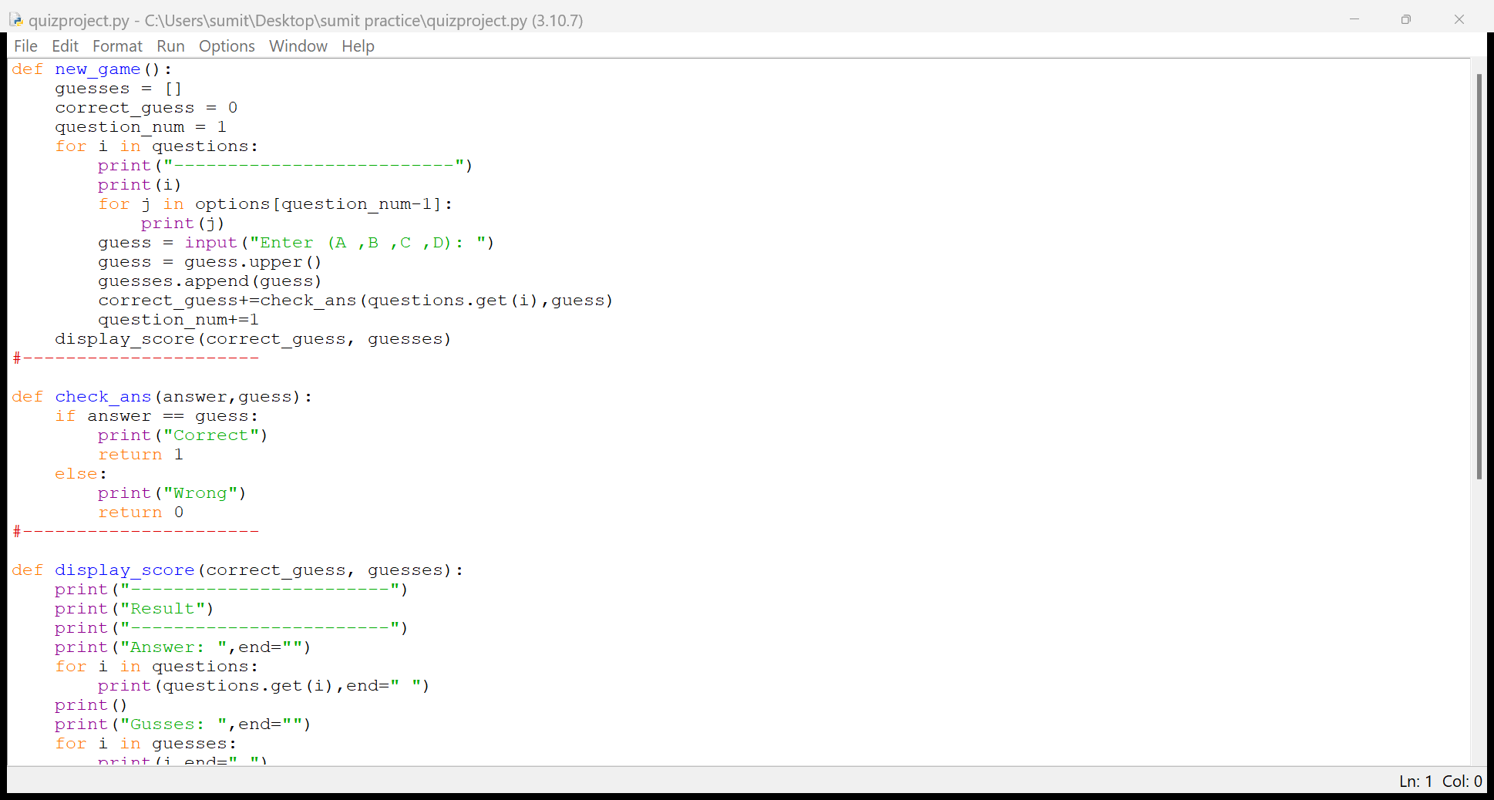
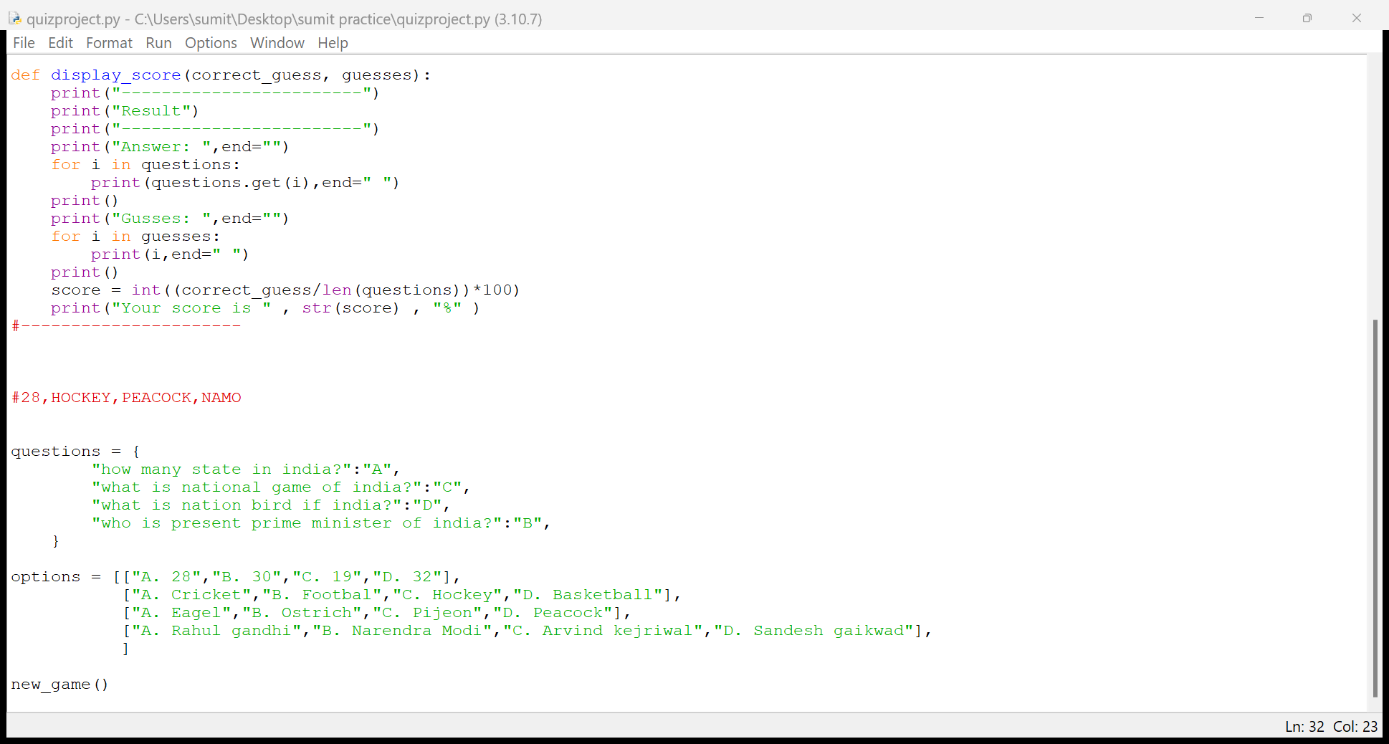
CODE OF QUIZ PROGRAM

Slide 6
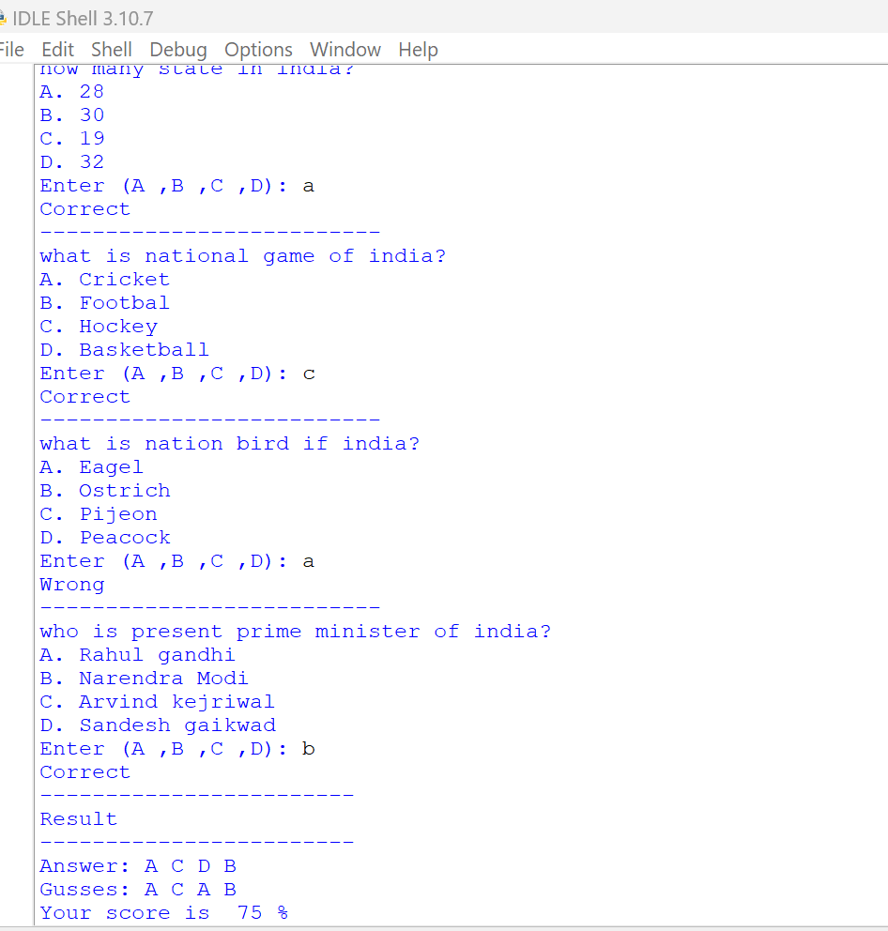
OUTPUT OF QUIZ PROGRAM CODE

Slide 7
REFERENCE - YOUTUBE
Video LINK - https://youtu.be/yriw5Zh406s
THANK TOU

